Slide 1

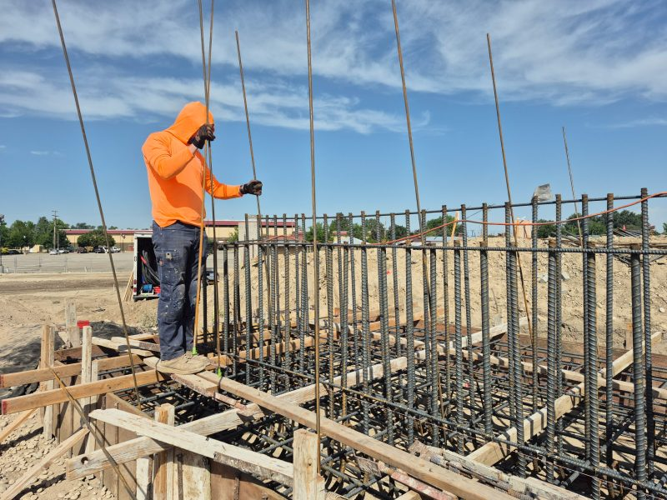
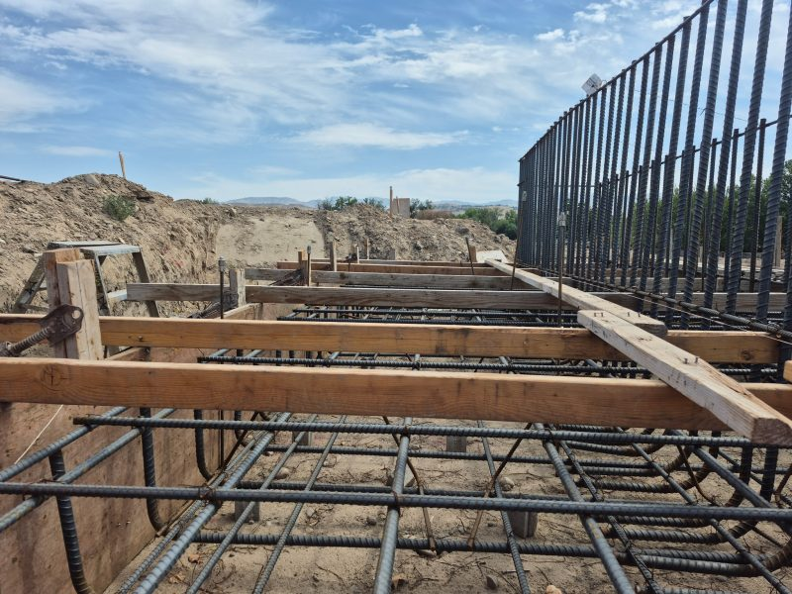
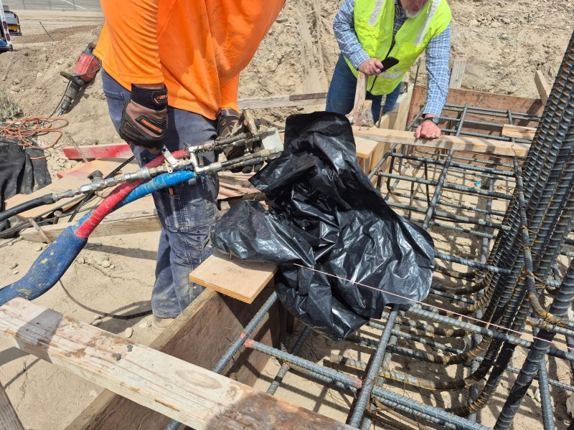
Boise Parks Bridge Abutment
Boise – Fair Grounds, Idaho • Soil Stabilization
PROBLEM
PROJECT PHOTOS
After the bridge abutment excavation, compacted road mix dried out and developed cracks and fissures. The rebar structure had already been built on top of the fill before the fissures appeared. Leaving the soils in this condition risked future settlement and could have forced costly rework and schedule delays.
bridge-abutment rebar and subgrade injection work (image 1)
SOLUTION
We installed steel deep injection tubes on a tight spacing pattern to ensure full coverage, then injected structural foam at depth to improve soil integrity and load-bearing capacity throughout the support zone. This approach stabilized the subgrade without dismantling and rebuilding the rebar assembly.
bridge-abutment rebar and subgrade injection work (image 2)
RESULT
The contractor avoided major rework and saved significant cost. The treated area achieved rapid strength gain, reaching most of its strength in minutes, so bridge construction could continue immediately.
bridge-abutment rebar and subgrade injection work (image 3)
208-780-9292 • gopolyflow.com
POLYFLOW | CASE STUDY

