Slide 1

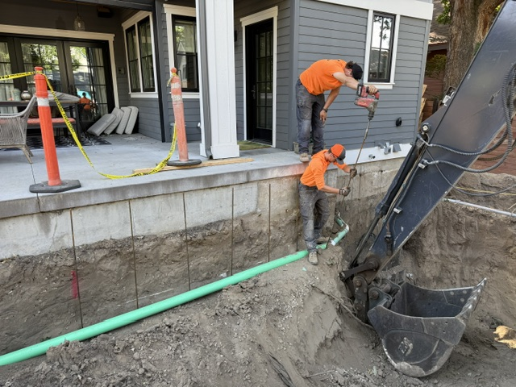
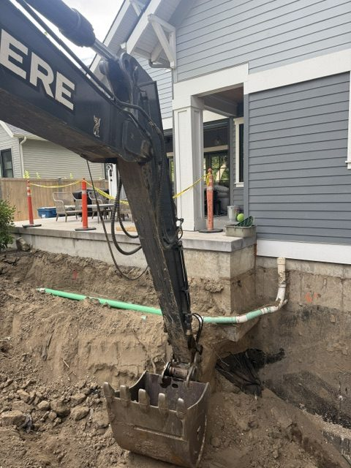
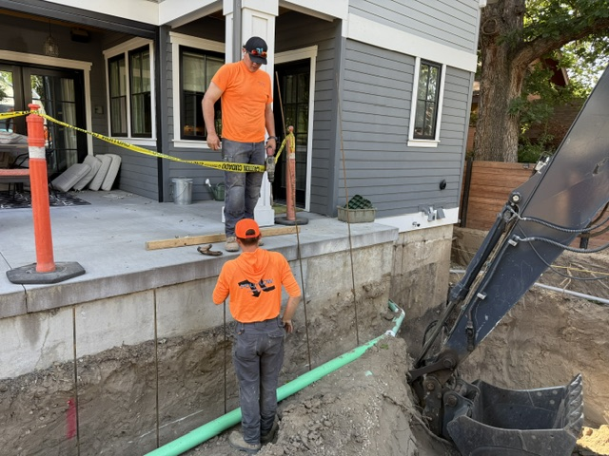
Chemical Shoring Basement Build
Downtown Boise, Idaho • Soil Stabilization
PROBLEM
PROJECT PHOTOS
During a renovation and addition project, excavation soils were not holding shape and were sloughing into the dig. Unstable excavation walls create serious safety risks for crews and can jeopardize nearby structures. In dense urban settings, loss of soil support can compromise existing footings and adjacent improvements.
basement-addition excavation and chemical-shoring work (image 1)
SOLUTION
We performed chemical shoring using a single-component polyurethane soil binding system. Steel injection tubes were driven to the required depth and a low-viscosity polyurethane was injected to bind sandy soils and fill voids. In the presence of soil moisture, the product reacts and expands modestly, then cures over approximately 24 hours into a solid, excavatable mass, allowing excavation to proceed safely.
basement-addition excavation and chemical-shoring work (image 2)
RESULT
The excavation was stabilized quickly and reliably, improving jobsite safety and protecting surrounding structures. The contractor was able to continue work with confidence once curing was complete.
basement-addition excavation and chemical-shoring work (image 3)
208-780-9292 • gopolyflow.com
POLYFLOW | CASE STUDY

