Slide 1

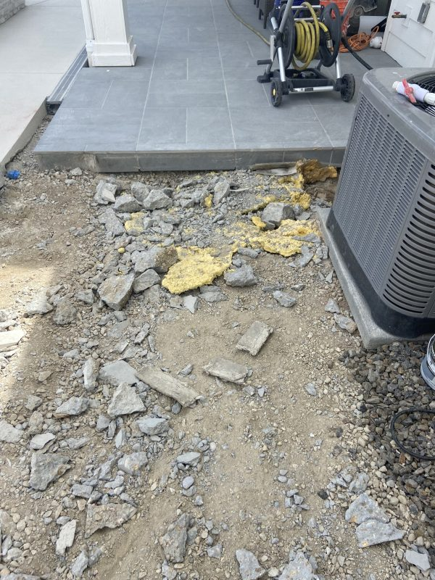
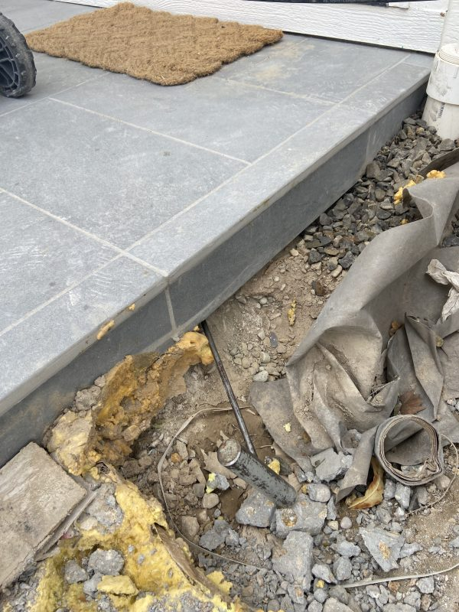
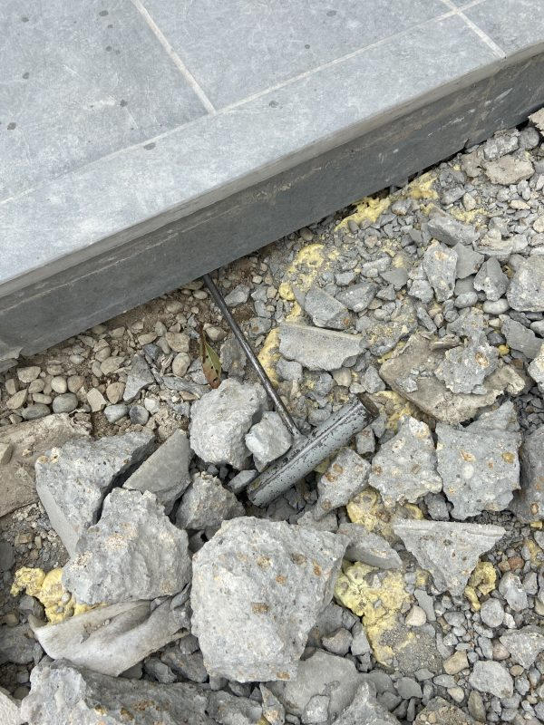
Cistron Water Leak Repair
Eagle, Idaho • Crack and Joint Sealing
PROBLEM
PROJECT PHOTOS
This site presented two related issues. Water was leaking around the main pipe entering the cistern, escaping through concrete at the penetration. Over time, the leak caused deep erosion, creating a large void beneath the pump house slab and contributing to slab settlement.
SOLUTION
pump-house slab edge and exposed voided subbase (image 1)
After draining the cistern below the leak elevation, our technician used proper confined-space safety measures to access the penetration. We installed a combination of oakum and water-activated polyurethane to seal the annular space, forming a flexible, durable gasket. Once the leak path was sealed, we filled the void beneath the pump house and lifted the settled concrete to restore support.
pump-house slab edge and exposed voided subbase (image 2)
RESULT
The penetration leak was sealed and the slab was stabilized. By pairing waterproofing and void fill, the repair corrected both the water source and the resulting settlement.
pump-house slab edge and exposed voided subbase (image 3)
208-780-9292 • gopolyflow.com
POLYFLOW | CASE STUDY

