Slide 1

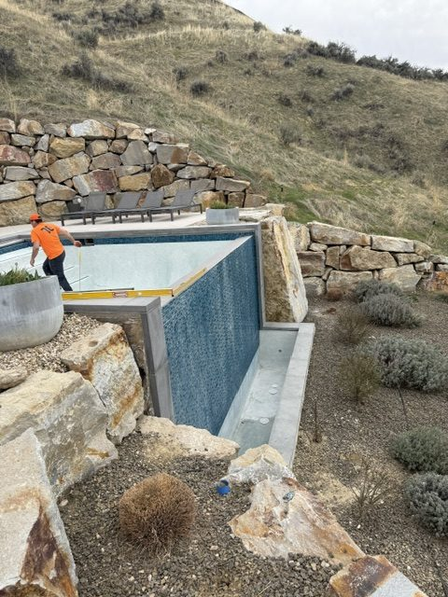
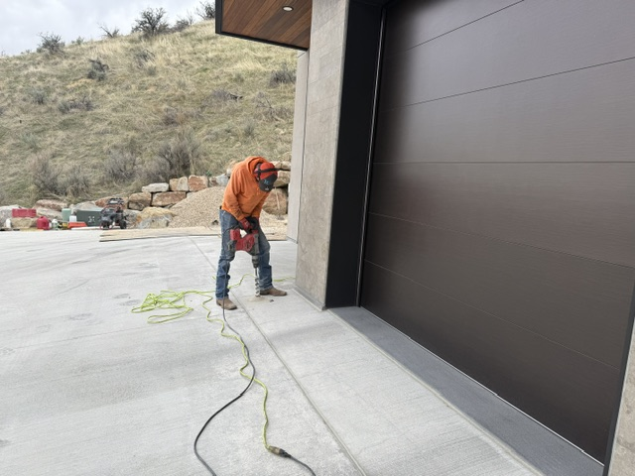
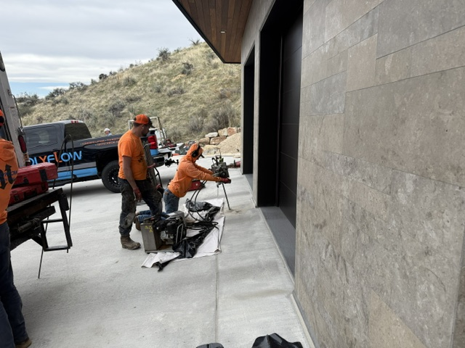
Deep Injection and Pool Stabilization
Boise, Idaho • Soil Stabilization
PROBLEM
PROJECT PHOTOS
This highly engineered, concrete-heavy home was built on a section of properly compacted road mix and supported by large, deep columns. Despite robust construction, early signs of settlement appeared. The homeowner also noticed movement around a built-in negative-edge pool. With heavy structural loads and premium finishes, early intervention was important to protect the investment.
SOLUTION
home and negative-edge pool stabilization work (image 1)
We created access points through the driveway and other areas to reach the deep structural columns. Using a drill rig and pilot holes, we advanced steel injection tubes to approximately 20 to 22 feet and injected high-density structural polyurethane foam around the columns to improve the surrounding soil's load-bearing capacity. At the same time, a second crew stabilized the pool perimeter with deep injections around the pool edges. Where needed, we also drilled through the pool bottom to fill voids and obtain as much lift as possible.
home and negative-edge pool stabilization work (image 2)
RESULT
The columns and pool were stabilized, reducing the risk of continued settlement. While the pool did not achieve full lift to the original target, it received enough lift and reinforcement to confirm stabilization and restore confidence in performance.
home and negative-edge pool stabilization work (image 3)
208-780-9292 • gopolyflow.com
POLYFLOW | CASE STUDY

