Slide 1

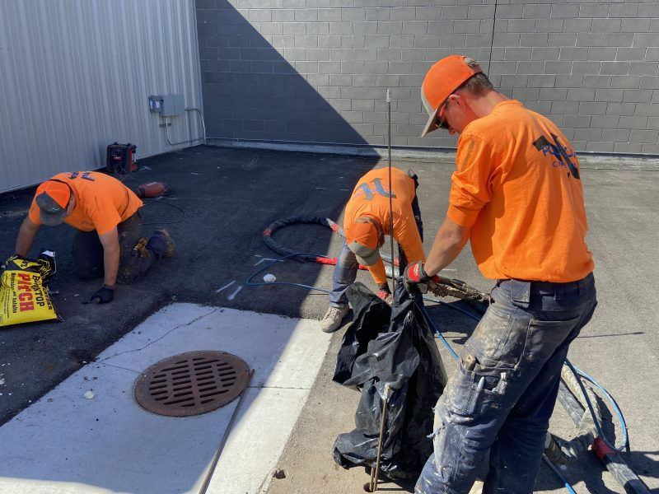
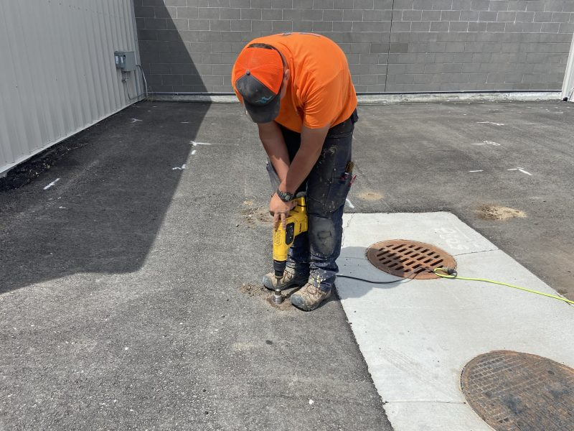
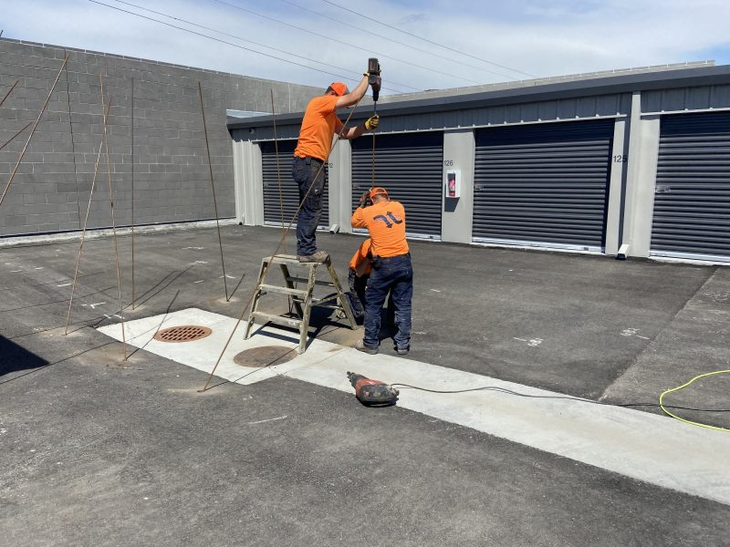
Deep Injection Storage Units
Meridian, Idaho • Soil Stabilization
PROBLEM
PROJECT PHOTOS
Even with strong geotechnical planning, localized conditions can vary outside test areas. At this site, certain zones showed settlement in asphalt drive lanes and near storage unit foundations, likely linked to unknown organic decomposition below grade.
SOLUTION
storage-unit pavement deep-injection work (image 1)
We drilled through the asphalt near the footings and drove steel injection tubes approximately 8 to 10 feet deep to treat soils beneath and adjacent to foundations. High-density structural polyurethane foam was injected to fill voids and increase load-bearing capacity. After completing injections, we patched access holes with asphalt cold patch to restore the surface quickly.
storage-unit pavement deep-injection work (image 2)
RESULT
Settlement concerns were addressed at depth and the driving surface was restored. The project delivered targeted stabilization while minimizing disruption to the facility.
storage-unit pavement deep-injection work (image 3)
208-780-9292 • gopolyflow.com
POLYFLOW | CASE STUDY

