Slide 1

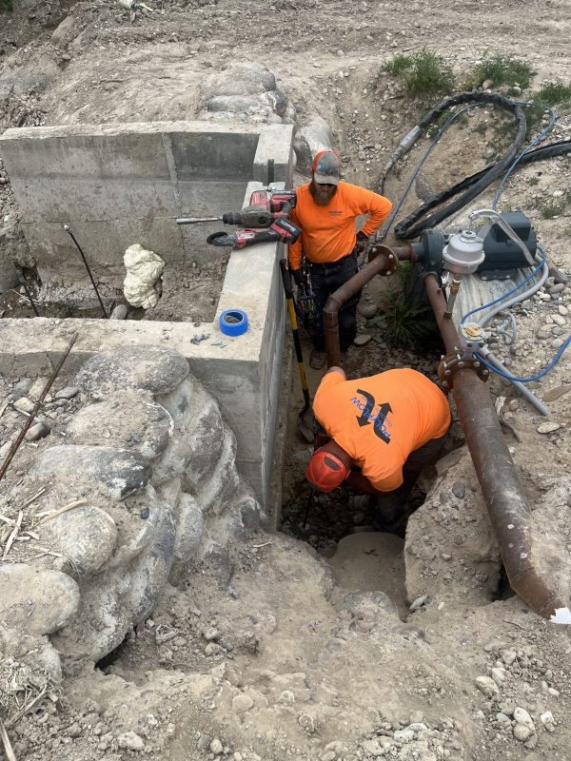
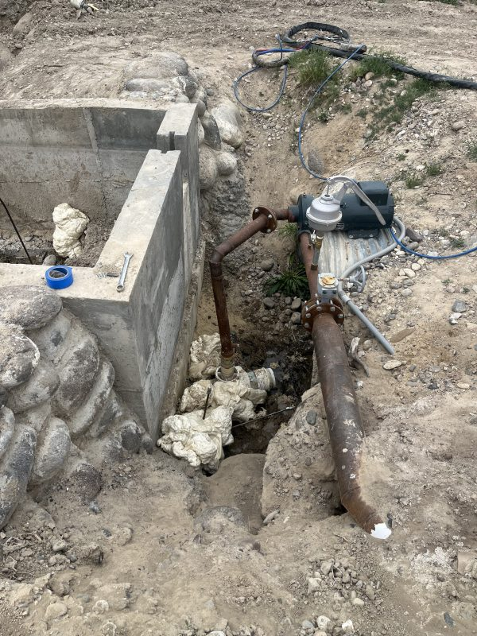
Erosion Around a Concrete Dam
Marsing, Idaho • Soil Stabilization
PROBLEM
PROJECT PHOTOS
A homeowner built a concrete dam in a creek to create a pond for irrigation storage. During backfill, boulders and road mix were placed around the structure. Once the pond filled, water found paths around the dam and washed out the road mix between boulders. The resulting voids prevented the dam from holding water reliably.
SOLUTION
We installed steel injection rods around the dam and injected high-expansion structural foam into the voided backfill, carefully controlling the application to avoid lifting or shifting the dam. The foam filled voids within the boulder matrix and sealed migration paths. We returned for a follow-up visit to touch up a few minor leak points.
technicians working beside the concrete dam excavation (image 1)
RESULT
The dam held water again and the pond returned to service. The stabilized backfill reduced washout risk, and the foam provided a durable void-fill solution suitable for long-term performance.
technicians working beside the concrete dam excavation (image 2)
208-780-9292 • gopolyflow.com
POLYFLOW | CASE STUDY

