Slide 1

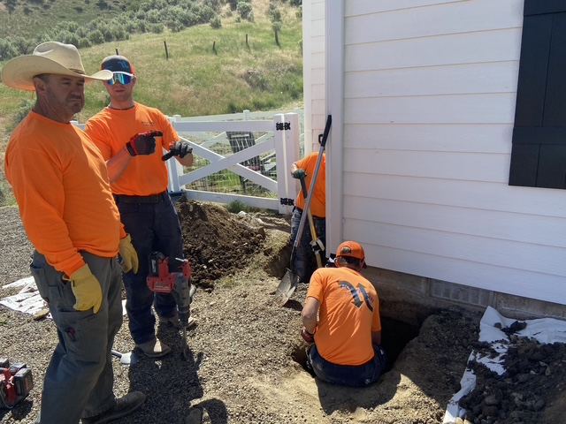
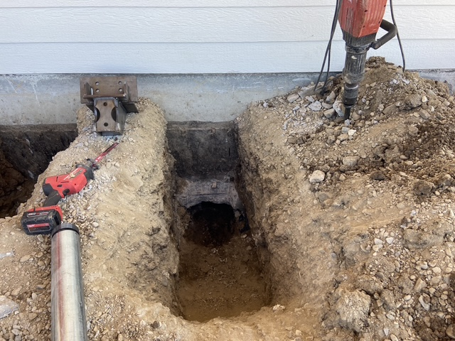
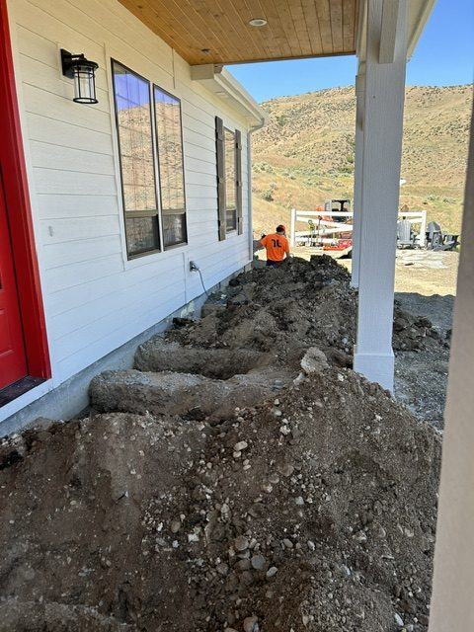
Foundation Repair
Horseshoe Bend, Idaho • Foundation Repair
PROBLEM
PROJECT PHOTOS
A newly constructed home settled about one inch at the front within a couple of years, leading to drywall cracking and doors that would not open or close properly. During the repair process, the root cause became clear: roof runoff was being routed through a perforated drain pipe sitting directly on the footing. Each rain event delivered water to the foundation edge, causing erosion and loss of supporting soils.
SOLUTION
house foundation excavation and push-pier work (image 1)
We removed the concrete front porch to access the foundation and excavated at each pier location. We removed the necessary portion of footing to install heavy-duty brackets rated for 90,000 pounds directly beneath the stem wall. Push piers were hydraulically driven to competent load-bearing strata. We then used a daisy-chained, synchronized hydraulic jacking system to lift the home uniformly, limiting secondary damage. After reaching the desired elevation, the structure was locked in place with the bracket hardware. Excavations were backfilled and compacted in lifts, and a new concrete porch was poured using experienced subcontractors.
house foundation excavation and push-pier work (image 2)
RESULT
The home was restored to proper elevation and permanently supported. The project corrected both the symptoms and the underlying cause, delivering a durable repair the homeowner can trust.
house foundation excavation and push-pier work (image 3)
208-780-9292 • gopolyflow.com
POLYFLOW | CASE STUDY

