Slide 1

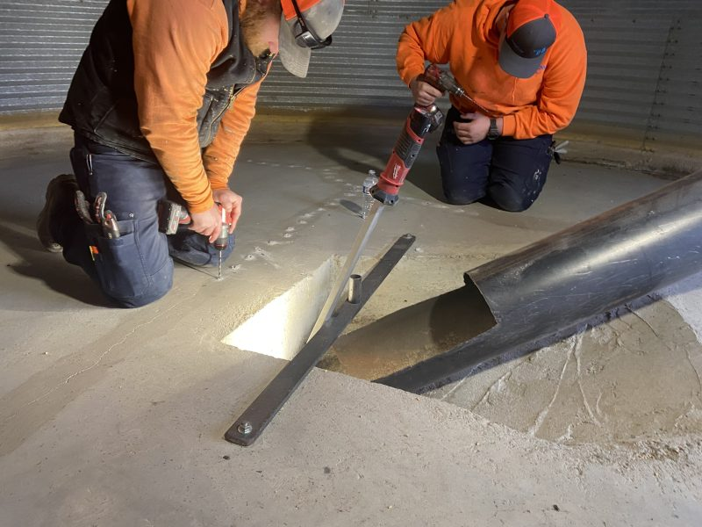
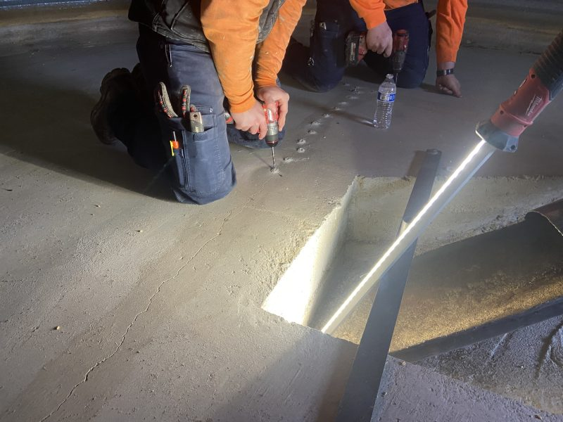
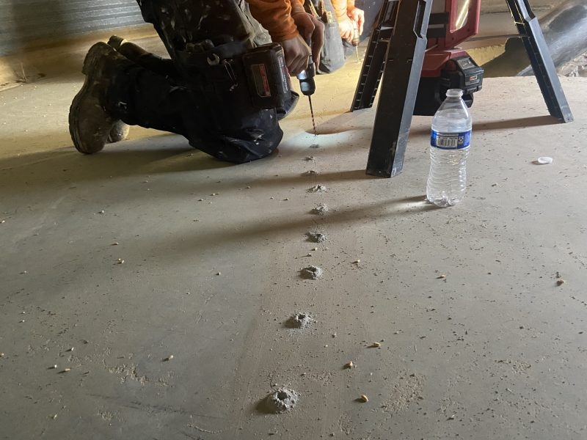
Grain Silo Waterproofing
Homedale, Idaho • Crack and Joint Sealing
PROBLEM
PROJECT PHOTOS
Cracks at the base of grain bins were allowing water to enter the silo, causing grain rot and financial loss. Previous attempts using surface sealants and even spray foam coatings failed to stop water migration through the concrete, so intrusion continued.
SOLUTION
grain-silo concrete crack and pressure-grouting work (image 1)
We removed the failed spray foam and thoroughly cleaned the cracks. We then drilled injection ports and performed pressure grouting using a water-activated polyurethane grout. By pre-wetting the crack, we encouraged the grout to chase water through the crack path, creating a sealed, waterproofed crack from within the concrete rather than a superficial coating.
grain-silo concrete crack and pressure-grouting work (image 2)
RESULT
Water intrusion was addressed using an engineered pressure grouting method appropriate for active conditions. The sealed cracks helped protect stored grain and restore reliable performance of the silo.
grain-silo concrete crack and pressure-grouting work (image 3)
208-780-9292 • gopolyflow.com
POLYFLOW | CASE STUDY

