Slide 1

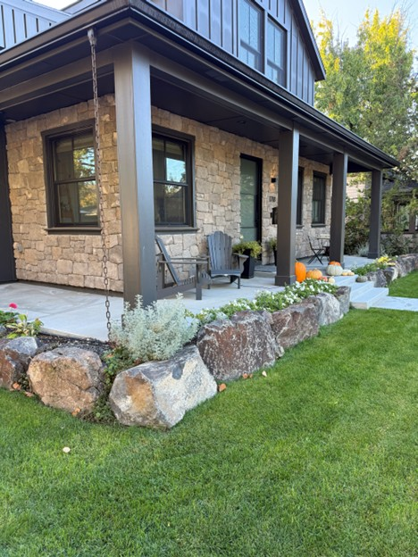
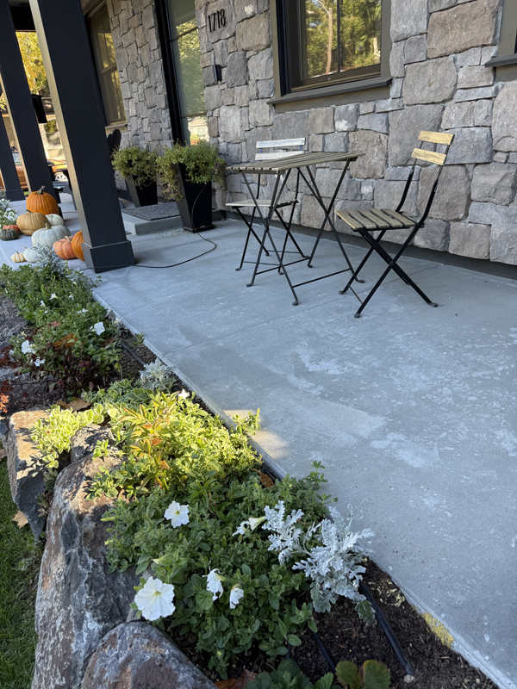
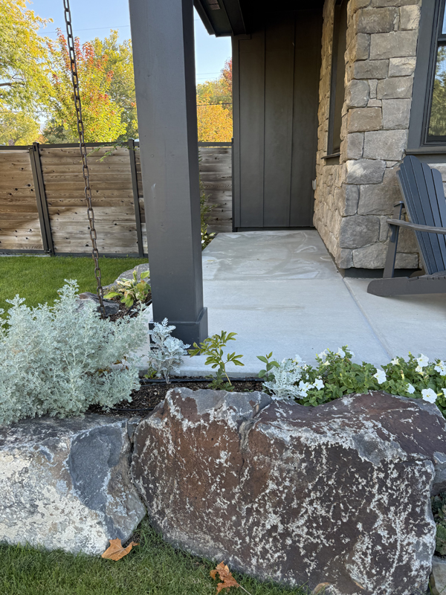
Heavy Front Porch Lift
Northend Boise, Idaho • Concrete Lifting
PROBLEM
PROJECT PHOTOS
During a remodel, a basement was added beneath an existing home. To create the basement footprint, the soils around the house were excavated and later backfilled without being compacted in proper lifts. As that loose fill consolidated, the front porch settled. A prior attempt by another concrete lifting contractor injected foam beneath the slab, but it did not address the deeper, compromised soils, so the porch continued to resettle.
settled front porch at remodeled home (image 1)
SOLUTION
We started with a thorough inspection to confirm the true cause of movement. Using steel injection tubes, we performed deep injection to densify and stabilize the soils below the porch, discovering and filling voids as we advanced, with some injections reaching about 10 feet deep. After the unconsolidated deep soils were compacted, we drilled small 3/8-inch lift holes and carried out controlled slab lifting to bring the porch back to grade, all without disturbing landscaping or removing concrete.
settled front porch at remodeled home (image 2)
RESULT
The porch was returned to its original height and stabilized for long-term performance. By fixing the deep soil first, the lift became a durable solution, not a short-term cosmetic repair.
settled front porch at remodeled home (image 3)
208-780-9292 • gopolyflow.com
POLYFLOW | CASE STUDY

