Slide 1

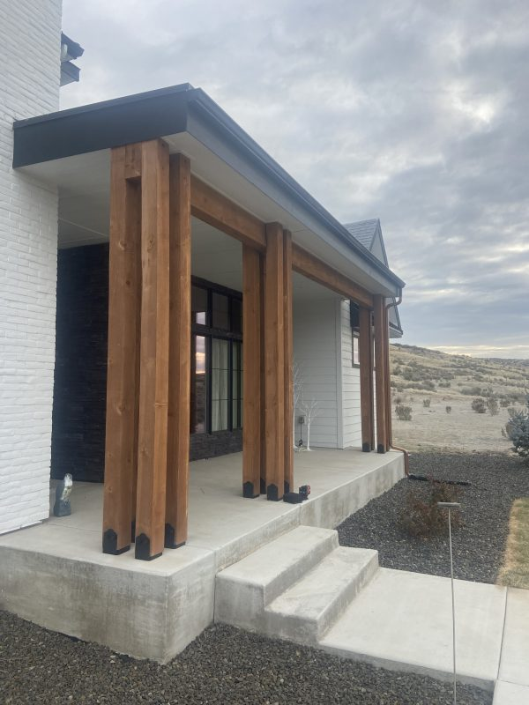
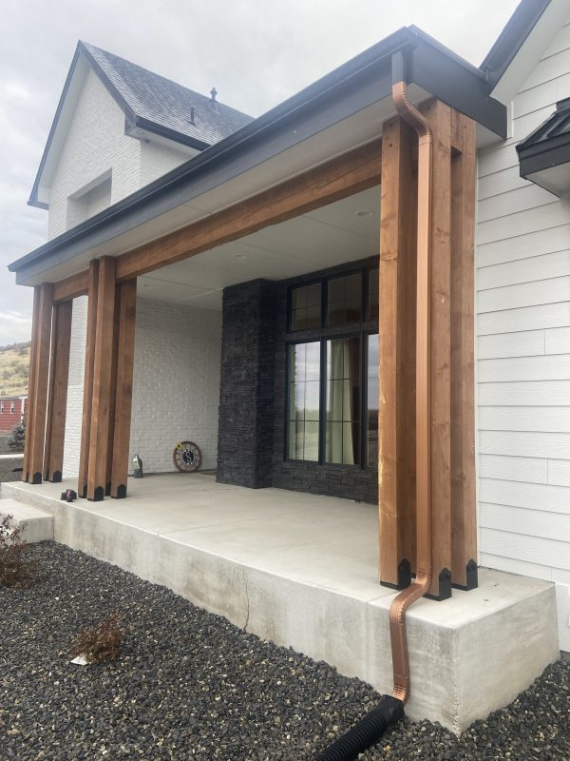
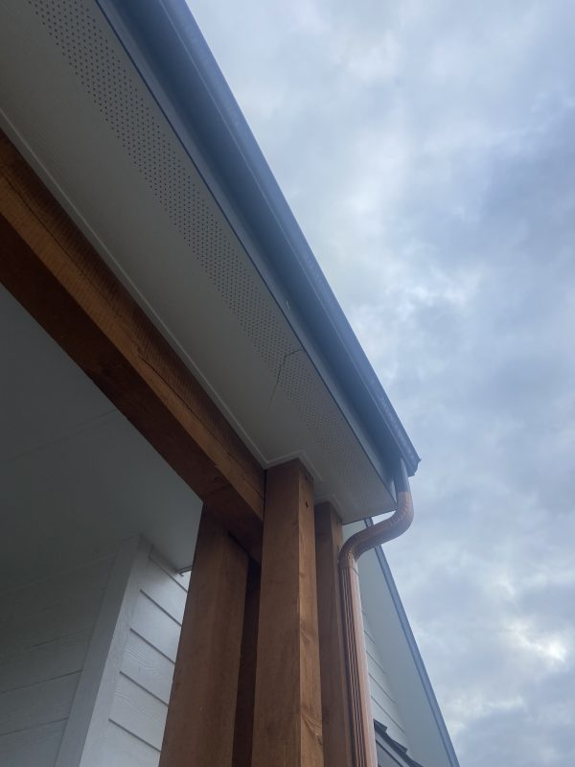
Large and Heavy Front Porch
Star, Idaho • Concrete Lifting
PROBLEM
PROJECT PHOTOS
This is a common issue on new construction with basement foundations. After forming and pouring the basement walls, excavation spoils are backfilled against the foundation. If that backfill is not compacted in proper lifts, the soils will consolidate over time. In this project, the lack of compaction led to settlement and cracking in a large, heavy front porch.
SOLUTION
new home's heavy front porch and adjacent concrete (image 1)
We drilled small 5/8-inch access holes and used injection tubes to reach the bottom of the basement wall across the porch footprint. We then injected high-density structural foam in a controlled sequence, compacting loose soils from the bottom up before performing the slab lift. Once stable, we lifted the porch back to its original grade and height without removing the slab or disturbing landscaping. Joints and cracks were sealed with a flexible sealant and dressed with sand for a clean finish.
new home's heavy front porch and adjacent concrete (image 2)
RESULT
The porch was restored and stabilized with minimal disruption. Cracks remained visible, but they were properly sealed to prevent water intrusion and protect the slab and subgrade.
new home's heavy front porch and adjacent concrete (image 3)
208-780-9292 • gopolyflow.com
POLYFLOW | CASE STUDY

