Slide 1

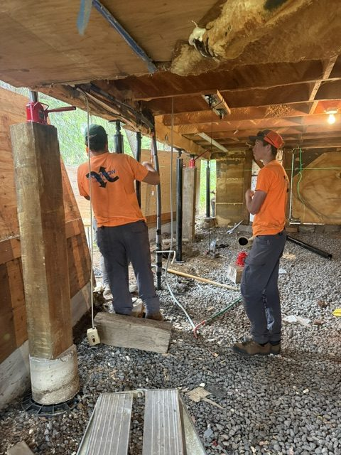
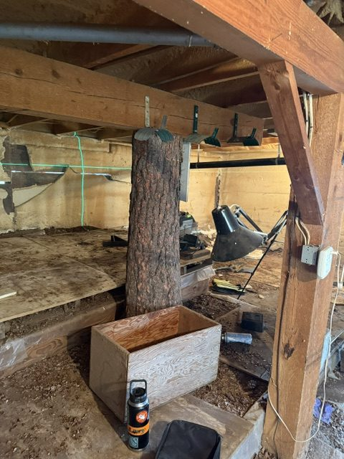
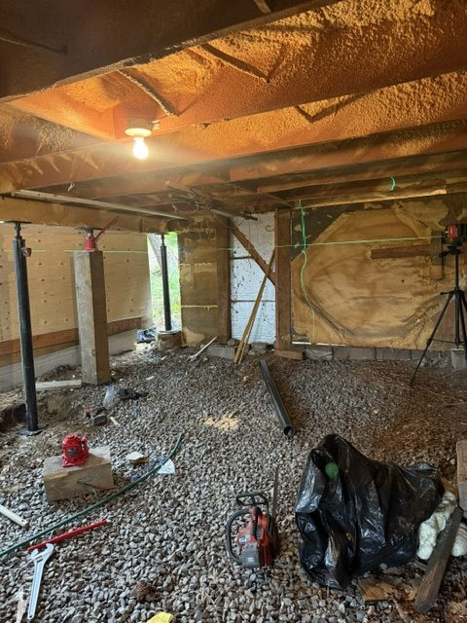
Leveling a House and Deck With Crawl Jacks
Cascade, Idaho • Foundation Repair
PROBLEM
PROJECT PHOTOS
This home was built with a post-and-beam system, including a support post that was literally a tree. Over time, natural decomposition and erosion reduced the post's capacity, and the structure settled more than two inches. The movement began to show up inside the home, affecting how the living space felt and functioned. The adjacent deck also shifted out of level, adding to the homeowner's concerns.
house crawl-space supports and adjacent deck (image 1)
SOLUTION
After an on-site evaluation, we walked the homeowner through options with a focus on preserving the structure and avoiding unnecessary rebuild costs. We installed a crawl jack support system, which is highly adaptable because steel support pipes can be cut to fit the specific conditions. Using laser levels, we methodically placed and adjusted each jack to lift and support the home. We then applied the same approach to level the deck.
house crawl-space supports and adjacent deck (image 2)
RESULT
The home and deck were restored to level and properly supported. The homeowner achieved a stable, long-term fix with minimal disruption and without rebuilding the entire structure to current code.
house crawl-space supports and adjacent deck (image 3)
208-780-9292 • gopolyflow.com
POLYFLOW | CASE STUDY

