Slide 1

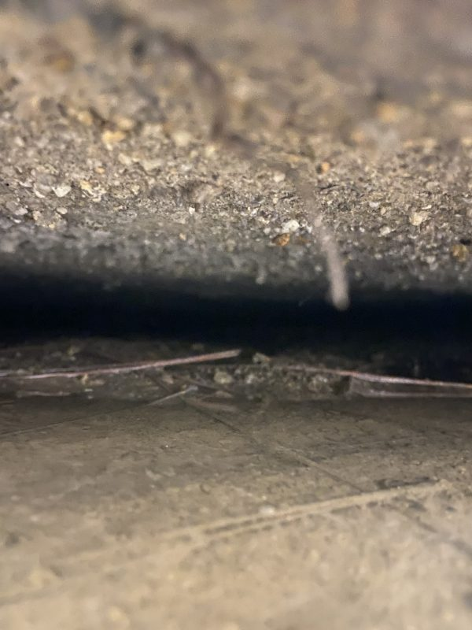
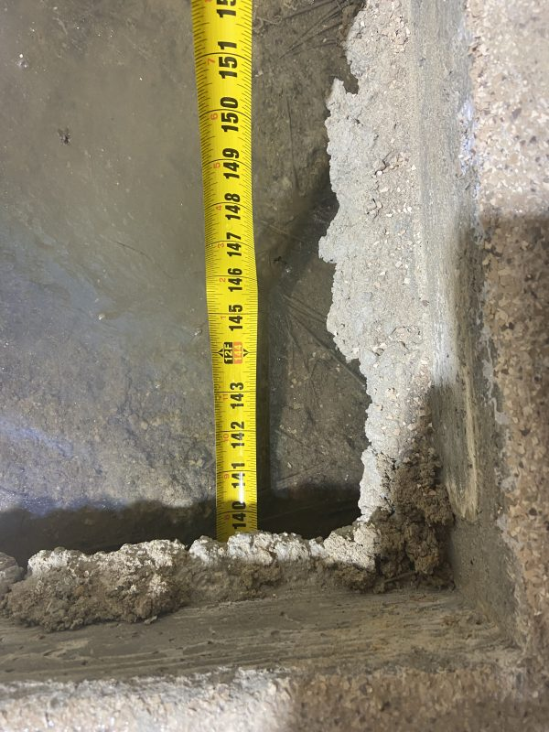
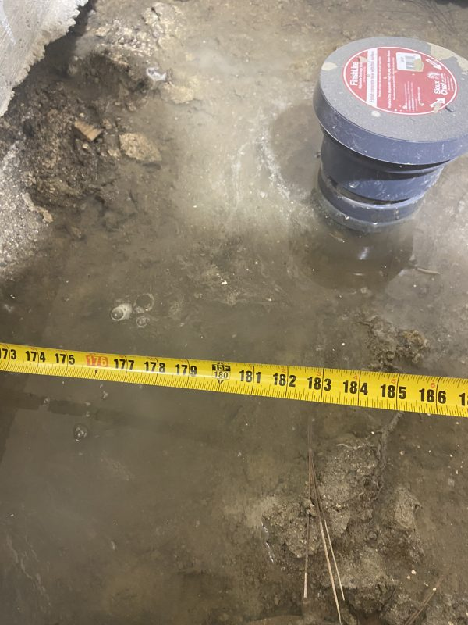
Void Fill Under Shop Floor
Cascade, Idaho • Soil Stabilization
PROBLEM
PROJECT PHOTOS
Improper drainage and insufficient compaction caused erosion beneath a shop floor, creating voids in the sub-base. The underlying soils were also not ideal load-bearing material. Although the floor had not yet settled significantly, the space was empty and the owner wanted the issue corrected before heavy use and equipment loading began.
SOLUTION
shop-floor void inspection and measurement (image 1)
Because the floor was an epoxy-coated concrete slab, we drilled clean access points through the epoxy and used deep injection steel tubes to reach competent native soil. We performed deep injection where needed and then filled remaining voids with high-density structural foam. Dial meters were used throughout the process to ensure we filled and stabilized the subgrade without lifting the finished slab, measuring movement in thousandths of an inch.
shop-floor void inspection and measurement (image 2)
RESULT
The sub-base was stabilized and voids were filled without disturbing the finished epoxy floor. The owner gained confidence that the slab was supported and ready for future use.
shop-floor void inspection and measurement (image 3)
208-780-9292 • gopolyflow.com
POLYFLOW | CASE STUDY

